Slide 1
COURSE: Mini Project
COURSE CODE: 17EEEW301
SUBMITTED TO: Project Co Ordinator
PRESENTED BY:
Bhavana Jadhav 01FE18BEE501
K Shivappa 01FE19BEE419
Dhanesh S P 01FE19BEE415
Kusuma N 01FE17BEE037
Guide: Asst Prof Pavana

Slide 2
Speed Control of Brushless Dc Motor Using Fuzzy Logic Controller

Slide 3
Abstract:
This paper presents a control scheme of a fuzzy logic for the brushless direct current (BLDC) permanent magnet motor drives. The mathematical model of BLDC motor and fuzzy logic algorithm is derived. The controller is designed to tracks variations of speed references and stabilizes the output speed during load variations. The BLDC has some advantages compare to the others type of motors, however the nonlinearity of the BLDC motor drive characteristics, because it is difficult to handle by using conventional proportional integral (PI) controller. The BLDC motor is fed from the inverter where the rotor position and current controller is the input. In order to overcome this main problem, the fuzzy logic control is learned continuously and gradually becomes the main effective control. The effectiveness of the proposed method is verified by develop simulation model in MATLAB using c program. The simulation results show that the proposed fuzzy logic controller (FLC) produce significant improvement control performance compare to the PI controller for both condition controlling speed reference variations and load disturbance variations. Fuzzy logic is introduced in order to suppressing the chattering and enhancing the robustness of the controlled system. Fuzzy boundary layer is developed to provide smother transition to the equivalent control. Smaller overshoot in the speed response and much better disturbance rejecting capabilities.

Slide 4
INTRODUCTION :
Brushless DC (BLDC) servomotor drives have been widely used in aeronautics, electric vehicles, robotics, and food & chemical industries.
P,PI & PID controller are being used with the BLDC servomotor drive control system to achieve satisfactory transient and steady state response.
Now a days PID & FUZZY logic controllers are the main controller being used to control BLDC.
It is essential to know the exact mathematical model of the systems or response of the system for designing these controller.

Slide 5
What is BLDC?
A brushless DC motor (also known as a BLDC motor or BL motor)
The controller provides pulses of current to the motor windings which control the speed and torque of the synchronous motor.
highly efficient
permanent magnets rotate around a fixed armature
Commutation with electronics has a large scope of capabilities and flexibility.

Slide 6
Comparison of conventional and Brushless DC motors:
 | Conventional motors | Brushless motors
Mechanical structure | Field magnets on the stator | Field magnets on the rotor similar AC synchronous motor
Distinctive features | Quick response and excellent controlability | Long-lasting Easy maintenance (usually no maintenance required)
Winding connections | Ring connection The simplest:Δ connection | The highest grade:Δ or Y-Connection three-phase connection
 |  | Normal:Y-connection three-phase winding with grounded neutral point or four-phase connection The simplest: Two-phase connection
Commutation method | Mechanical contact between brushes and commutator | Electronic switching using transistors
Detecting method of rotor’s positions | Automatically detected by brushes | Hall element,optical encoder,etc.
Reversing method | By a reverse of terminal voltage | Rearranging logic sequencer

Slide 7
Principle operation of Brushless DC (BLDC) Motor
The basic block diagram brushless dc motor is shown below.
The brush less dc motor consist of four main parts power
1) converter : It converts power from source to PMSM, it uses inverters to convert DC source power to AC power, which in turn converts electrical energy to mechanical energy.
2) permanent magnet-synchronous machine (PMSM) : It consists of BLDC motor
3) sensors : The sensors are comprised of PI controller sensors that control the speed of motor, rotor position , torque , voltage, starting of the bldc motor
4) control algorithm : control algorithms determine the gate signal to each semiconductor in the power electronic converter, based on the rotor position and command signals which may be a torque command ,voltage command ,speed command

Slide 8

Basic Block diagram of BLDC motor

Slide 9
Advantages of speed control BLDC control
They have higher efficiency.
They have long life due to lack of electrical and frictional losses.
This motors are spark free because of absence of brushes.
This motors are noiseless.
Disadvantages of speed control BLDC motors
The cost of a brushless DC motor is comparatively higher as compared to brushed DC motor and the electronic controller also increases the cost of overall setup, as in a traditional motor, low-cost mechanical commutation setup involving brushes is used.
When brushless DC motor is operated at low speed, slight vibrations occur during low-speed rotation. However, vibrations reduce at high speed.

Slide 10
Main objectives:
To model the BLDC motor
Using the machine dynamic modeling method to model the bldc motor
Controling the bldc motor speed with conventional methods(PI-controller)
Controling the speed of bldc motor by matlab stimulation
To control the bldc motor speed using fuzzy logic and comparing the
different speed controlling techniques

Slide 11
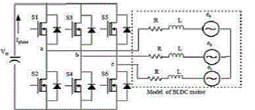
A mathematical model of BLDC motor: MODELING OF BLDC MOTOR (Machine Dynamic Model):

Slide 12







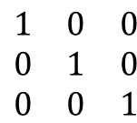




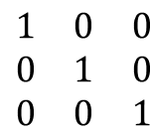
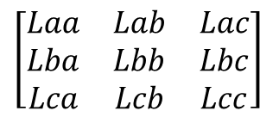


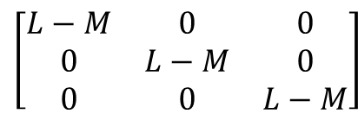

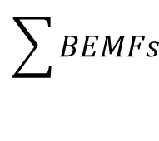

$$\begin{matrix}Vas−Vn \\ Vbs−Vn \\ Vcs−Vn\end{matrix}$$
$$\left[\begin{matrix}Rs & 0 & 0 \\ 0 & Rs & 0 \\ 0 & 0 & Rs\end{matrix}\right]$$
$$\begin{matrix}Ia \\ Ib \\ Ic\end{matrix}$$
$$\left[\begin{matrix}Laa & Lab & Lac \\ Lba & Lbb & Lbc \\ Lca & Lcb & Lcc\end{matrix}\right]$$
$$\begin{matrix}Ia \\ Ib \\ Ic\end{matrix}$$
$$\begin{matrix}Ea \\ Eb \\ Ec\end{matrix}$$
=
P
+
+
……1
$$\sum{BEMFs}$$
V=$\frac{1}{3}\begin{matrix}Vas & Vbs & Vcs \end{matrix}$
…………..2
-
$$\begin{matrix}Va \\ Vb \\ Vc\end{matrix}$$
$$\begin{matrix}1 & 0 & 0 \\ 0 & 1 & 0 \\ 0 & 0 & 1\end{matrix}$$
$$\left[\begin{matrix}L & M & M \\ M & L & M \\ 0 & M & L\end{matrix}\right]$$
=
Rs
$$\begin{matrix}Ia \\ Ib \\ Ic\end{matrix}$$
+
$$\begin{matrix}Ia \\ Ib \\ Ic\end{matrix}$$
$$\begin{matrix}Ea \\ Eb \\ Ec\end{matrix}$$
…………3
P
+
Simplifying the eq 3 further we get :
$$\begin{matrix}Vas \\ Vbs \\ Vcs\end{matrix}$$
$$\begin{matrix}Ia \\ Ib \\ Ic\end{matrix}$$
$$\left[\begin{matrix}L−M & 0 & 0 \\ 0 & L−M & 0 \\ 0 & 0 & L−M\end{matrix}\right]$$
=
Rs
$$\begin{matrix}1 & 0 & 0 \\ 0 & 1 & 0 \\ 0 & 0 & 1\end{matrix}$$
$$\begin{matrix}Ia \\ Ib \\ Ic\end{matrix}$$
$$\begin{matrix}Ea \\ Eb \\ Ec\end{matrix}$$
+
+
……….4
P
The generated electromagnetic torque is given by:
Te=[Ea Ia+Eb Ib+Ec Ic]/ꙍ(in N.m)……….5

Slide 13
Combining the all relevant equations,the system in state forms is
x=Ax+Bu+Ce……………6
Where
X=[ia ib ic ꙍm ϴr]^t…….7
So the final eq we get here is
U=[Vas Vbs Vcs Tl ] ^t ………….8
and
e=[ea eb ec]^t…………….9

Slide 14
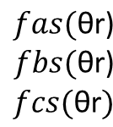

Modeling of Back EMF using Rotor Position
The phase back EMF in the BLDC motor is trapezoidal in nature and is the function of the speed ω m and rotor position angle θr.
The phase back EMF’S can be expressed as.
$$\begin{matrix}ea \\ eb \\ ec\end{matrix}$$
$$\begin{matrix}fas(\text{θ}\text{r}\text{)} \\ fbs(\text{θ}\text{r}\text{)} \\ fcs(\text{θ}\text{r})\end{matrix}$$
=
ωm λm
…………………..10
Where $fas(\text{θ}\text{r}$), $fbs(\text{θ}\text{r}$) and $fcs(\text{θ}\text{r}$) as are unit function generator to corresponding to the trapezoidal induced emfs of the of BLDCM as a function of $\text{θ}\text{r}$.The $fbs\left(\text{θ}\text{r}\right),fcs(\text{θ}\text{r}$) are similar to $fas(\text{θ}\text{r}$) but phase displacement of 120 degree .

Slide 15
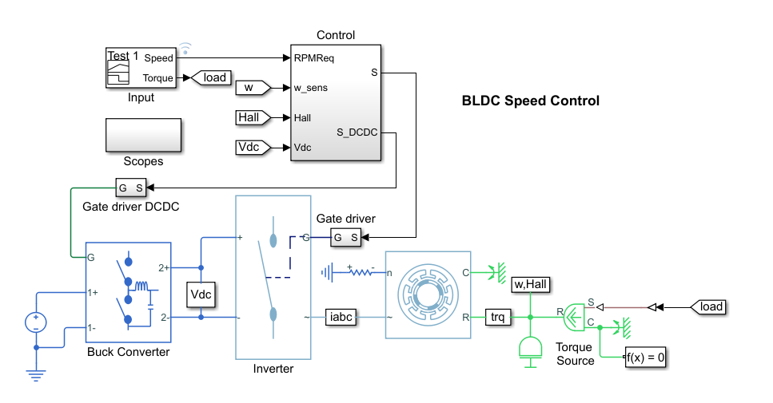
BLDC Speed Control model:

Slide 16
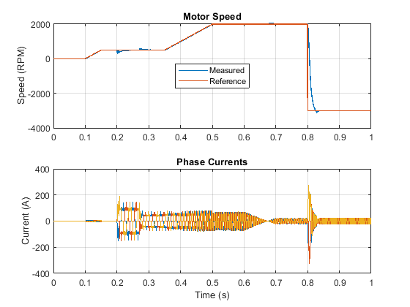
The plot below shows the requested and measured speed for the test and the phase currents in the electric drive.

Slide 17
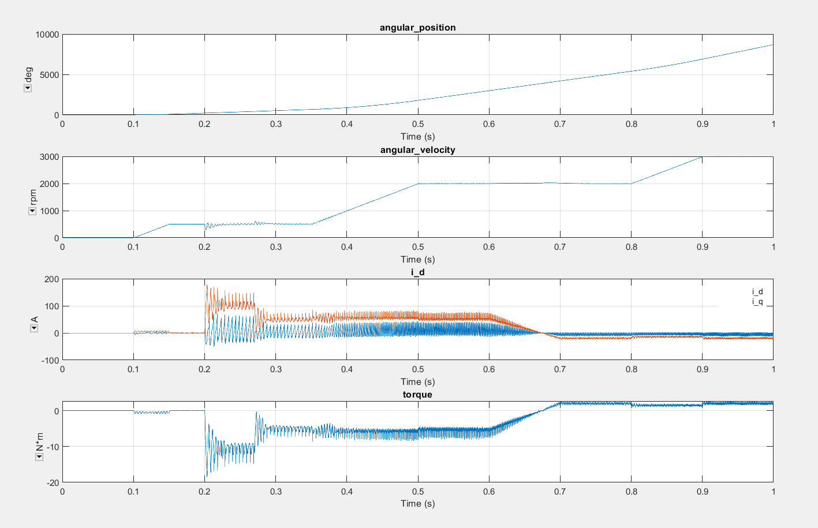

Slide 18
Thank you

